Slide 1




Industrial Training (LI)
KA30005/KE30005/KC30005/ KM30005/KS30005/KG30005

Slide 2
Introduction
Course Code: KA30005/KE30005/KC30005/KM00505/KS30005/KG30005
Course Name: Industrial Training
Semester: Semester II 2021/2022
Credit Hours: 5
LI Duration: 10 weeks (25 Jul 2022 – 31 Sept 2022**)
Admin Staff: Alice Ruslin (FKJ office)
**subject to change based on academic calendar of BPA UMS

Slide 3
Course Outcomes
Course Outcomes (COs) | Program Outcomes (POs) | Assessment Method
CO1 An ability to carry out tasks and responsibilities ethically | PO8 : Ethics | Industrial supervisor assessment
CO2 An ability to cooperate and work effectively in a team | PO9 : Individual & Team Work | Industrial supervisor assessment
CO3 An ability to articulate technical knowledge/ information/ideas | PO10 : Communication | Industrial supervisor assessment
CO4 An ability to write technical documents / reports related to their work | PO10 : Communication | Academic supervisor assessment - Logbook (technical) & report (technical)
CO5 An ability to utilize relevant technical resources for the completion of task | PO12 : Lifelong Learning | Academic supervisor assessment - Report (format & referencing)
CO6 An ability to manage the implementation of project or task on time | PO11 : Project Management & Finance | Industrial supervisor assessment

Slide 4
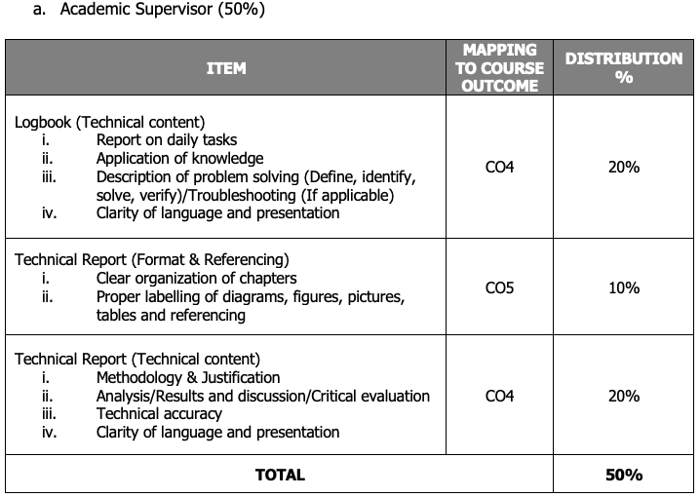
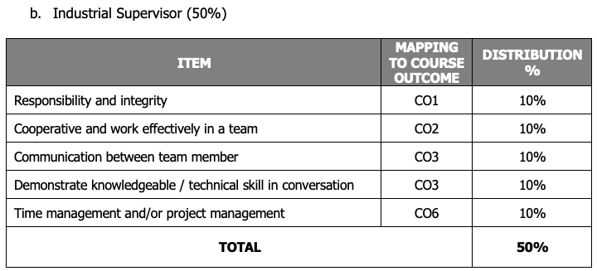
Evaluation
Marks | Grade | Description
0 - 49 | G (Fail) | Did not complete the training and/or plagiarism of report writing
50 - 89 | L (Pass) | Exhibit satisfactory behaviour during the training, and satisfactory logbook and report writing.
90 - 100 | LC (Pass with Distinction) | Exhibit excellent characteristics during training, excellent technical report writing, and able to apply knowledge at work (shown in logbook)

Slide 5
Communication
HK03 Co-Ordinator: Ir. Dr. SARIAH ABANG
+60 16 253 9057
sariah@ums.edu.my
Room No.16 Block A, FKJ, UMS

Slide 6
Process
 | Pre-registration Process
1. | Log in to (LI) in https://obe.ums.edu.my/li/default.aspx
2. | Fill-in LI-1 form in LI system
3. | Prepare and upload CV in LI system
 | Application Process
4. | Submit THREE (3) companies details (Address, Contact person & number, Fax and email) to academic office.
5. | Get cover letter via email/system after approval from Program’s LI coordinator. Send the cover letter together with your CV to the companies.
6. | Follow-up with companies. Any reply from the companies should be forwarded to academic office (lifkj@ums.edu.my). Inform us, which company you would like to go to, if you have more than 1 offer.
7. | If no reply from the companies, provide another THREE (3) new companies details to academic office for a new request.
 | Actions
8. | Get a LI confirmation letter via email. Send it to company. Every students must have place for LI.
9. | Students undergo Industrial Training

Slide 7
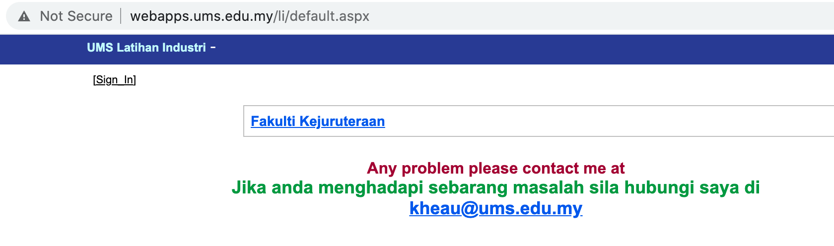
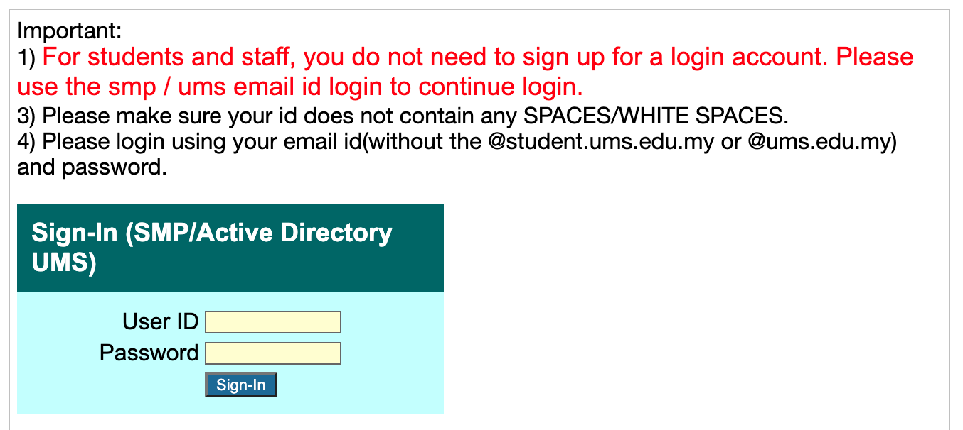
FKJ LI System
https://obe.ums.edu.my/li/default.aspx
1
Click to log in
??
For system problem, contact Dr Chung.
Please introduce your name, matrix number, program and description of your problem with screenshot, if possible.
2
Read instruction
3
Log in using your SMP/UMS email ID
??
For enquiry about LI, contact program LI coordinator/Pn Alice
If you fail to log in, try use the same ID and password in the SMP system. 99% problem reported is because student forgot password/ID

Slide 8
Documents
LI Handbook 2021 (for student)
LI Logbook 2021 (for student)
Info Book for Company 2021 (for industrial supervisor)
student to hand in a copy to industrial supervisor
Forms
Fill in by student: LI-2, LI-3D, LI-5, LI-6
Prepare by student and hand to industrial supervisor (week-5): LI-3B, LI-4B
Email first, then the original copy to be submitted by student in sealed envelope, together with LI report
Prepare by student during Lecturer’s visit/meeting: LI-3A
Lecturers to prepare and fill in LI-3A themselves (if it is a call/virtual meeting)

Slide 9
Process Flow (Before LI)
Num | Description | Important dates
 |  | Sem I | Sem II
1 | Submission of student registration form (LI-1) | Feb 2022 – 14 Mar 2022
2 | Registration of course (Industrial Training) in UMS’s SMP |  | 14 Mar 2022 – 01 Apr 2022** (1 week)
3 | Industrial placement application and confirmation |  | 14 Mar 2022 – 19 Jun 2022** (13 Weeks)
4 | Industrial placement finalization by FKJ/Program and briefing #2 on tasks during and after LI |  | 19 Jun 2022 - 26 Jun 2022** (1 Weeks )
 | Leave application (For SUKSIS, PALAPES, etc.) |  | 27 May 2022 Week 10
**subject to change based on academic calendar of BPA UMS

Slide 10

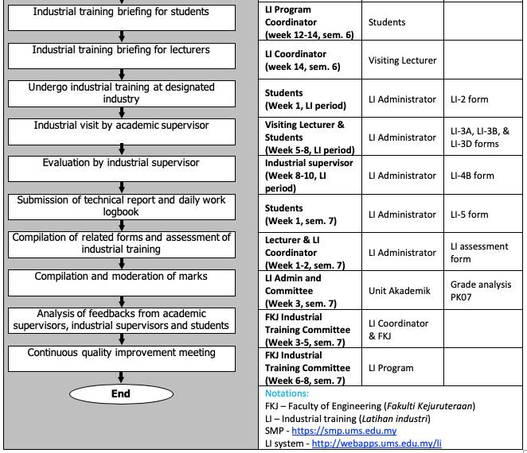
Process Flow (During and After LI)
25 Jul 2022 – 31 Sept 2022
Important timeline
During
Week 1 (25 Jul-29 Jul. 2022)
Week 5-8 (22Aug.-16 Sept. 2022)
Week 8-10 (16 Sept. – 31 sept. 2022)
After
First Monday of Week 1,
next semester (TBA)*
*Program LI Coordinator to update on date and methods to submit the report and logbook, suitable for respective program.
For those LI over 10 weeks, timeline of submission remains unchanged to enable grading on time (please consult with respective program coordinator)

Slide 11
Summary of Important dates
Bil | Activity | Tentative Dateline | Important Dates | Location
1 | Industrial training briefing for students |  | 15 Mac 2022 | Online by Program’s LI Coordinator
2 | (a) Preparation of CV, (2) online registration on FKJ’s LI system (LI-1), (c) upload your CV in the LI system |  | Feb 2022 – 14 Mar 2022 | LI FKJ system: https://obe.ums.edu.my/li/default.aspx (Sign in using SMP ID and password)
3 | Registration of course (Industrial Training) in SMP | (week 1, sem. 6) | 14 Mar 2022 – 22 Mar 2022** | SMP UMS
4 | Add/Drop of course (Industrial Training) in SMP | (week 1-3, sem. 6) | 14 Mar 2022 – 03 Apr 2022** | SMP UMS
5 | Application and confirmation of industrial training placement | (week 1-14, sem. 6) | 14 Mar 2022 – 27 Jun 2022** | LI FKJ system
 | Industrial Training | (semester break) | 25 Jul 2022 – 02 Oct 2022**
**subject to change based on academic calendar of BPA UMS

Slide 12
LI Overseas
For students who interested to do internship abroad, they have to submit their personal detail, country for intern, address company to the coordinator LI program.
After get confirmation letter from the company, student have to prepare early the following documents:
1) Offer letter with detail information from organization/ company.
2) personal information detail form
3) 1 copy first page passport (expired date must after LI duration)
4) Completed agreement letter
5) Completed letter of indemnity & consent

Slide 13
Company/ Organization Criteria
Companies chosen for the industrial training are able to expose students and made them familiar with common engineering processes at a practical level
Civil, Electrical & Electronic, Computer, Chemical, Mechanical, Oil & Gas Engineering/ Engineering related organization
Formal working hours and working environment
All students MUST BE supervised by an Engineer (or supervisor with engineering background).
Note: Information on these companies are available in FKJ LI system. But don’t limit yourself only to these companies.

Slide 14
Responsibilities
Follow the standard of procedure (SOP) to prevent miscommunication. We will not take any responsibility in your Industrial Training commencement failure and you may risk failing your Industrial Training course.
Check and ensure that the contacts and addresses given are correct.
Keep a copy of every document.
Follow up on application progress with the company
Application letter sent or not?
Offer letter received or not?
Acceptance: Accept or Reject? Confirmation letter sent?
Keep us informed of your status for us to assist you better. Do not hide your offer letter, and wait for another offer.

Slide 15
List of Forms (See Appendix E)
FORMS NO. | ITEMS | METHOD OF APPLICATION/ SUBMISSION
LI – 1 | Student Registration Form | FYP LI System
LI – 2 | Industrial Training Commencement Form | Online
LI – 3A | Industrial Training Visit Form (FKJ Lecturer Report) | Hardcopy / Online
LI – 3B | Industrial Training Visit Form (Industrial Supervisor Report) Feedback on the Attributes of UMS Trainee Who is Currently Undergoing Industrial Training | Email*
LI – 3D | Industrial Training Visit Form (Student Feedback) | Online
LI – 4A | Industrial Training Evaluation Form (Academic Supervisor Report) | Email*
LI – 4B | Industrial Training Evaluation Form (Industrial Supervisor Report) | sariah@ums.edu.my
LI – 5 | Receipt of Industrial Training Report | Email*
LI – 6 | Leave application form | Email*

Slide 16
More details are available in the LI Handbook.

Slide 17
THANK YOU

